Slide 1

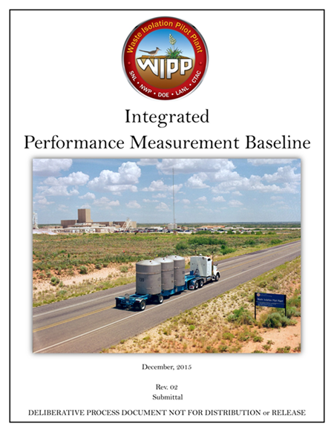
WIPP
Integrated
Performance Measurement Baseline Workshop
U.S. Department of Energy
Waste Isolation Pilot Plant
February 19, 2016

Slide 2
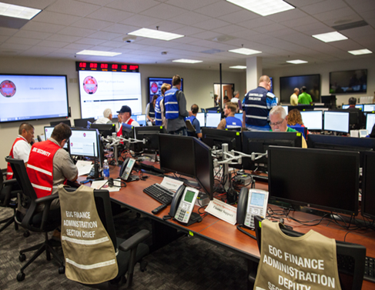
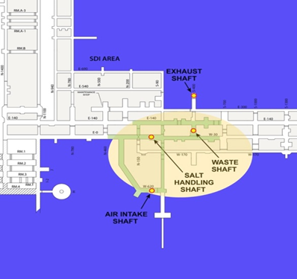
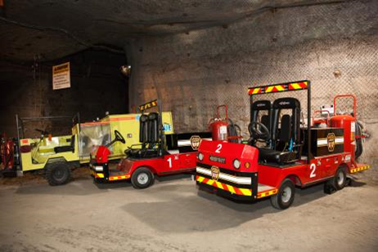
Agenda
Introduction and Workshop Objective
Integrated Performance
Measurement Baseline
Integrated PMB Details
CD-1 Process – Permanent
Ventilation System
Questions and Answers
New EOC
Combustible Control Zone
AIB/SMP Corrective Actions

Slide 3
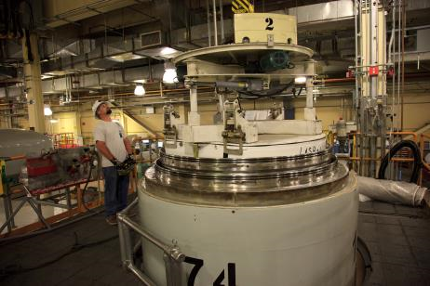
Introductions and Workshop Objective
Introductions
The objective of this workshop is to provide a forum for a detailed discussion of the WIPP Integrated Performance Measurement Baseline and to address stakeholder questions and comments
The review will include:
  Development of the Integrated
  Performance Measurement Baseline
  The scope and schedule critical path
  specific to the recovery effort
  Integrated PMB costs
  The risks and challenges associated
  with the recovery effort
  How progress is being monitored
  and measured

Slide 4
Integrated Performance
Measurement Baseline (PMB)
What is the Integrated PMB?
The DOE WIPP Project includes several participants
    Carlsbad Federal Office (CBFO)
    Nuclear Waste Partnership (NWP)
    Los Alamos National Laboratory-Carlsbad LANL)
    Sandia National Labs (SNL)
    Carlsbad Technical Assistant Contractor (CTAC)
The integrated PMB presents the scope, cost and schedule activities for all of the WIPP participants. It combines the previously issued Recovery PMB with Base Operations activities and the capital Asset Project (Permanent Ventilation System)
The integrated PMB is primarily focused on FY16 and FY17. This represents the current contract period.
The integrated PMB was developed to an 80% confidence level.
The integrated PMB was built utilizing 3 tools: Activity Based Cost sheets, Primavera P6 Scheduling Software and Cobra cost processor.
Changes to the baseline scope, schedule and estimate are being managed through a formal Change Control Process

Slide 5
Integrated PMB - Key Assumptions
Waste emplacement is scheduled to begin in December 2016, after a DOE Operational Readiness Review with the CH TRU waste stored at WIPP and site-derived TRU waste.
Pre-event emplacement rates is not expected to be achieved until the Permanent Ventilation System is brought online. After the emplacement of the Site-Derived waste and Contact Handled (CH) waste stored in the Waste Handling Building, then waste emplacement from the active TRU waste generator sites will begin with up to 5 shipments per week.
The waste hoist controller upgrades will start in FY17.

Slide 6
Integrated PMB Key Assumptions - continued
Pre-start required improvements in the Safety Management Programs at the WIPP site from the corrective action plans, in response to the Accident Investigation Reports, will be completed.
Annual audits of CBFO and direct CBFO participants (NWP, SNL-CB, LANL-CB), certification audits for the approval of new processes and for the initial certification of the CCP characterization activities at each TRU waste generator site and annually thereafter will continue to be required.
Support for the Carlsbad Environmental Monitoring and Research Center for its independent monitoring function will continue.

Slide 7
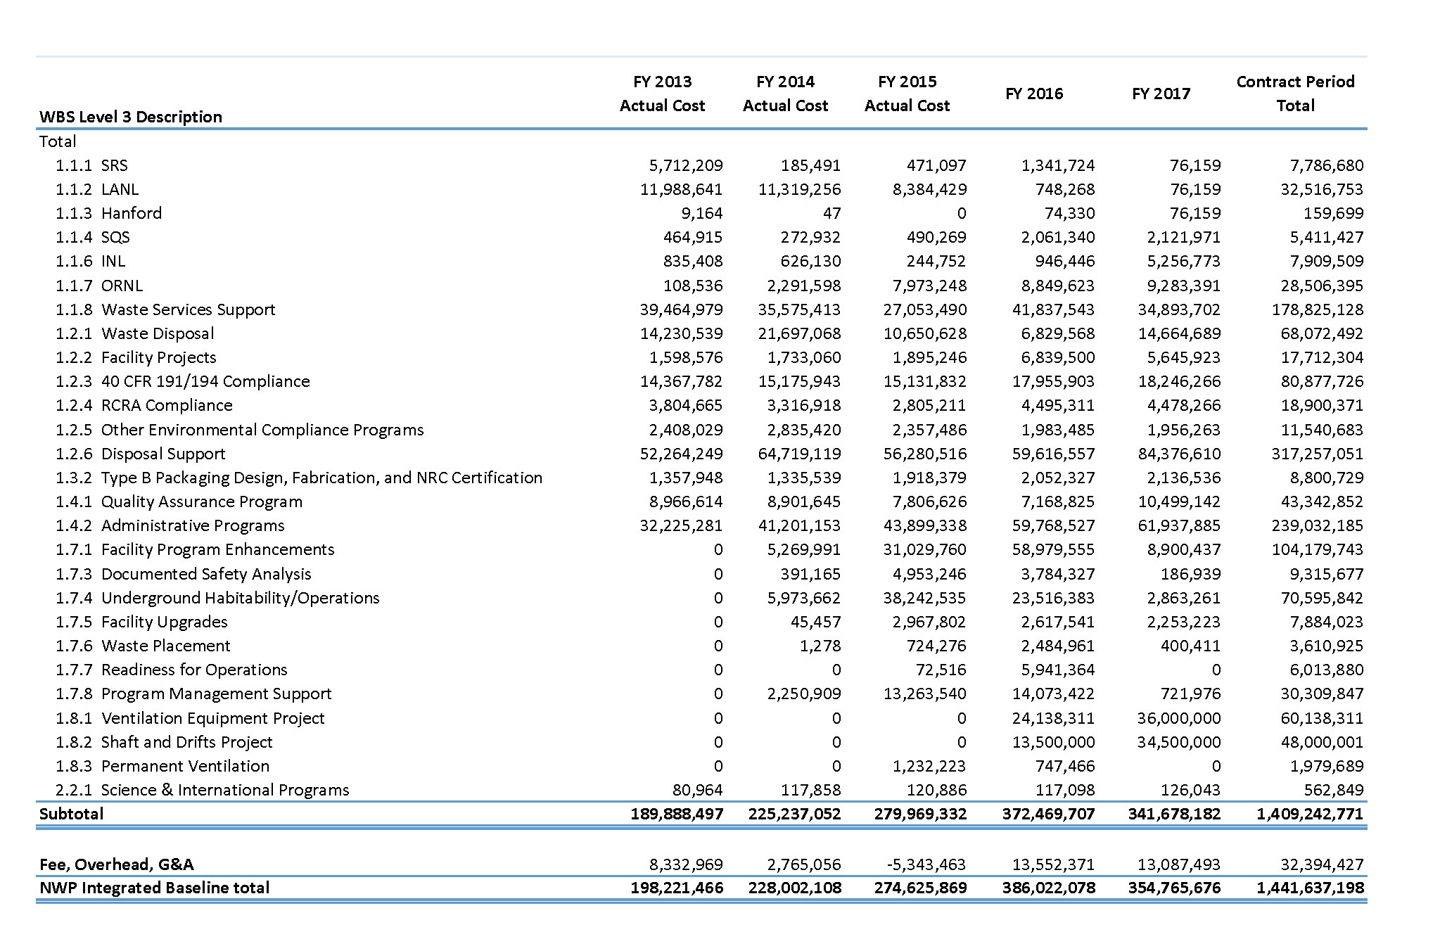
Integrated PMB – Cost Summary
Note: The costs in FY16 and FY17 reflect carryover dollars and are not New Budget Authority.
The FY17 budget is not finalized.

Slide 8
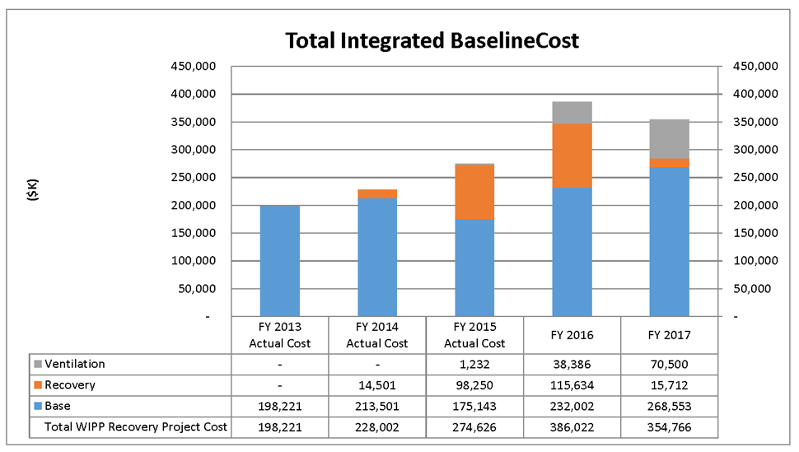
Integrated PMB – Cost Summary
Note: The total cost of Recovery is $244M . Other totals include carry over funding. The FY17 budget is not finalized.

Slide 9
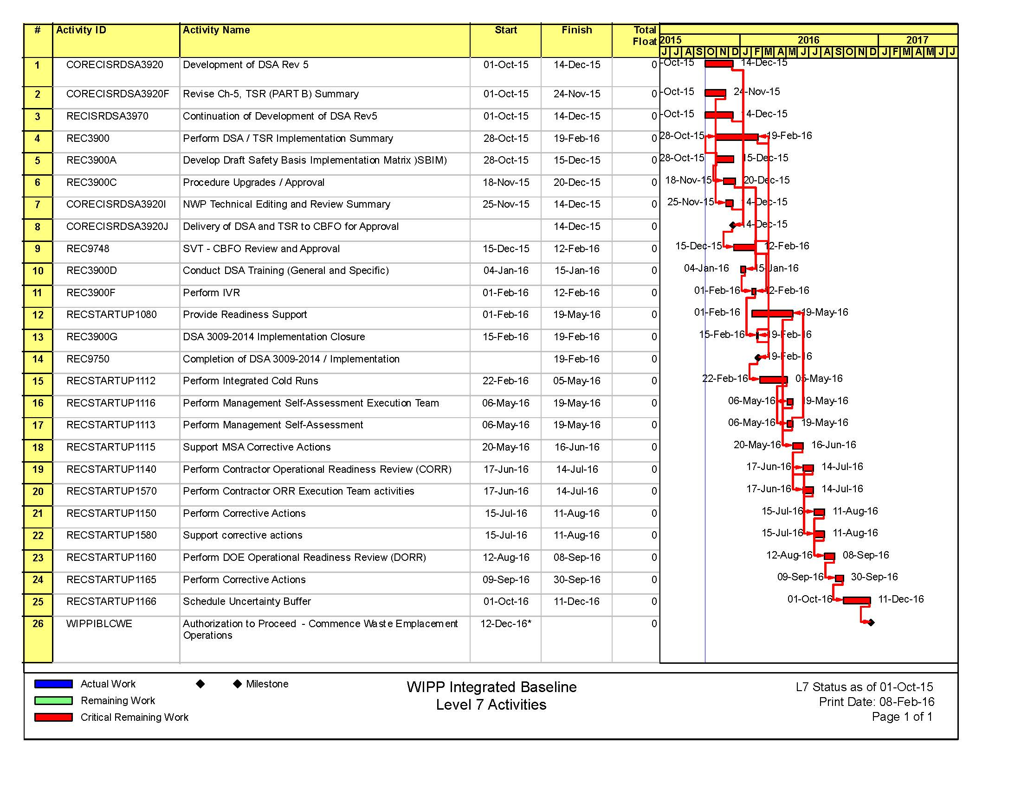

Slide 10
Documented Safety Analysis (DSA)
Safety Basis Documents are reviewed and approved by DOE as the rules (controls) to operate a nuclear facility.
The Safety Basis consists of 2 documents:
Documented Safety Analysis (DSA)
    The DSA documents the facility configuration, the processes to be performed, and analyzes accident scenarios appropriate for the facility and operations.
Technical Safety Requirements (TSRs)
    TSRs are “the rules” that come from the DSA analysis, and these rules are in place to reduce the probability and/or consequences of accident scenarios.
Notes:
Highlight key words: Documented safety ANALYSIS to ANALYZE hazards
Technical safety REQUIREMENTS to provide RULES.

Slide 11
DSA Hazard Analysis
Types of Accidents Analyzed in DSA
  Natural Phenomena Hazards (Earthquake, Tornado, Wind, Snow)
  Fires (pool fires, combustible fires, internal drum fires)
  Explosions, deflagrations
  Roof Falls
  Drops
  Punctures
  “Repeat Event” from February 2014 drum rupture (exothermic chemical reaction)
  The most significant accidents are fire, explosion and loss of confinement.

Slide 12
Sequence of Implementation
DSA/TSR
Submitted to
DOE for Approval
Procedures and Work
Documents updated (on hold)
Training Conducted
Surveillances Performed
SDDs Updated
ISI Performed
Backfit Analysis Performed
Implementation Validation
Review (IVR)
Conducted
DSA Rev 5
Implemented
Procedures and
Work Documents
Released
Daily and Shift
Surveillances
Performed
Allows:
- operation of ventilation systems
(UVFS/IVS/WHB)
surface and u/g liquid fueled
vehicles
- waste hoist
Real time monitoring at Panel
6/7
Does not Authorize:
SVS operation
Waste Handling(CH or RH)
Waste Emplacement
Receipt of offsite TRU waste
DOE Review and Approval of
DSA/TSR in the form of a
Safety Evaluation Report (SER)
And Authorization Agreement
Cold Operations,
MSA and ORRs
Performed
DOE Authorization to
Commence Waste
Emplacement
Emplacement of
TRU WASTE currently
stored in WHB
Generator Site
Readiness
Evaluations
WIPP Receipt of
New shipments
Notes:
Make note that DSA/TSR Rev 5 does not prohibit waste handling, waste emplacement or receipt of offsite waste – but DOE has to separately authorize those activities because they require a readiness review and a revision to the Authorization Agreement. DSA Rev 5 does prohibit operation of the SVS until a later change is made.

Slide 14
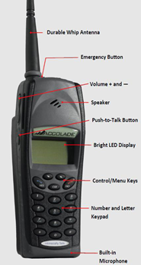
Perform Integrated Cold Runs
Demonstrate the Plant, People and Procedures are ready:
Plant
  Equipment necessary for receipt, processing and downloading of
  waste is available and properly functioning
  U/G Notification System, Localized Fire Suppression Systems in u/g
  People
  Demonstrate Nuclear Safety Culture and Conduct of Operations
  Standards
  Proficiency with new DSA controls (surveillances, operator rounds)
  Waste emplacement activities utilizing empty containers
  Maintenance evolutions
  Process
  Safety Management Program pre-start improvements are demonstrated
    Examples: Fire Protection, Radiological Controls, Emergency Management
  Conduct drills (Radiological event, injury, fire)
Notification
System
Radio

Slide 16
Readiness Activities
Readiness Activities are governed under DOE O 425.1D, Startup and Restart of Nuclear Facilities.
  The type of readiness activity to be performed is evaluated based on whether the activity is new, the length of time since an activity has been last performed and the complexity of the activity.
  Readiness activities range from a checklist to a formal review
  DOE approves the type of readiness activity
The type of readiness activity for resumption of waste emplacement at WIPP has been determined to be a DOE led Operational Readiness Review.
Prior to DOE conducting the Operational Readiness Review (ORR), it is prudent for the Contractor to conduct additional assessments to ensure they are ready.
These include a Management Self Assessment and a Contractor ORR.

Slide 18
Contractor Readiness Review (CORR)
Conducted by NWP prior to the DOE ORR utilizing a team of independent Subject Matter Experts
A Plan of Action for the CORR is developed to document the scope of the review and approved by the DOE
The CORR will focus on:
  Implementation of corrective actions associated with the AIB reports
  Implementation of Safety Management Program corrective actions
  Ensure the plant, people and the processes are ready for safe and compliant resumption of waste emplacement activities
From the Contractor ORR - Good Practices, Findings and Opportunities for Improvement may be identified. Findings that are considered to be pre-starts will be evaluated for closure prior to beginning the DOE Operational Readiness Review (CORR) or during the DOE ORR.
NWP will formally declare readiness to the DOE, prior to start of the DOE ORR.

Slide 20
DOE Readiness Review (DORR)
Conducted by the DOE utilizing a team of independent Subject Matter Experts to assess and determine if waste emplacement activities can be resumed.
Similar to the CORR, the DORR will focus on:
  Implementation of corrective actions associated with the AIB reports
  Implementation of Safety Management Program corrective actions
  The assessment will ensure the plant, people and the processes are ready for safe and compliant resumption of waste emplacement activities.
From the DOE ORR - Good Practices, Findings and Opportunities for Improvement may be identified. Findings considered to be a prestart activity for commencement of waste emplacement will be addressed and closed.
DOE will provide concurrence with the closure of the prestart findings.

Slide 22
Authorization to Proceed – Commence Waste Emplacement
Once the DOE has completed the DOE Operational Readiness Review and agreed upon prestart findings have been satisfactorily closed, authorization to Commence Waste Emplacement will be provided to NWP.
In conjunction with the DOE, NMED will perform an evaluation of readiness to restart waste emplacement activities as it applies to their areas of oversight.
  The current schedule has resumption of waste emplacement starting in December 2016

Slide 24
Integrated PMB – Risk Approach
How were risks identified?
A comprehensive risk and estimating uncertainty assessment was performed. The initial Recovery risk register was expanded to include those risks that could impact the WIPP base operational activity program to form an integrated risk register containing both Recovery Project and Base operational activity risks and opportunities.
Because the integrated baseline is primarily focused on FY16 and FY17 and the resumption of waste emplacement operations, a specific risk analysis was conducted for the risk items that have the potential to impact the resumption of waste emplacement operations.
Estimate Uncertainty (Management Reserve and Contingency)
A cost probability distribution was developed for each risk using the best, most likely and worst case residual cost impacts. The management reserve and contingency estimates have been rolled back into work activities to support resumption of waste emplacement.
Schedule Uncertainty
The analysis provides and estimate of schedule duration necessary to respond to realized risks.
An 80% schedule uncertainty was derived for the recovery scope.

Slide 25
Example - Resumption of Waste Emplacement Risk Events

Slide 26
Schedule Uncertainty Buffer
The Integrated PMB was developed with an 80% schedule confidence level.
The schedule buffer provides additional time to mitigate risks that affect the critical path schedule; eliminating or greatly reducing the potential to impact the commencement of waste emplacement.

Slide 27
Integrated PMB –
Monitoring of Progress
Plan of the Day (POD) meetings (Monday, Wednesday and Friday)
Review of the current two week window of schedule activities
The Champions status schedule activities to be performed in that window that are scheduled to start or scheduled to complete
Issues that would prevent activities from starting or completing as scheduled are discussed and a path forward is developed to minimize impact
Plan of the Week meetings (Tuesday)
A review of the critical path schedule
A review of the programmatic activities (Safety Management Programs, AIB actions)
Actions are taken to mitigate the critical path activities
Monthly Project Status Meetings with CBFO
Cost and schedule performance are reviewed against the baseline
Monthly Change Control Board Meeting
Changes to the baseline (schedule or cost) that impact schedule milestones or cost impacts greater than $250,000 are reviewed.

Slide 28


Slide 29
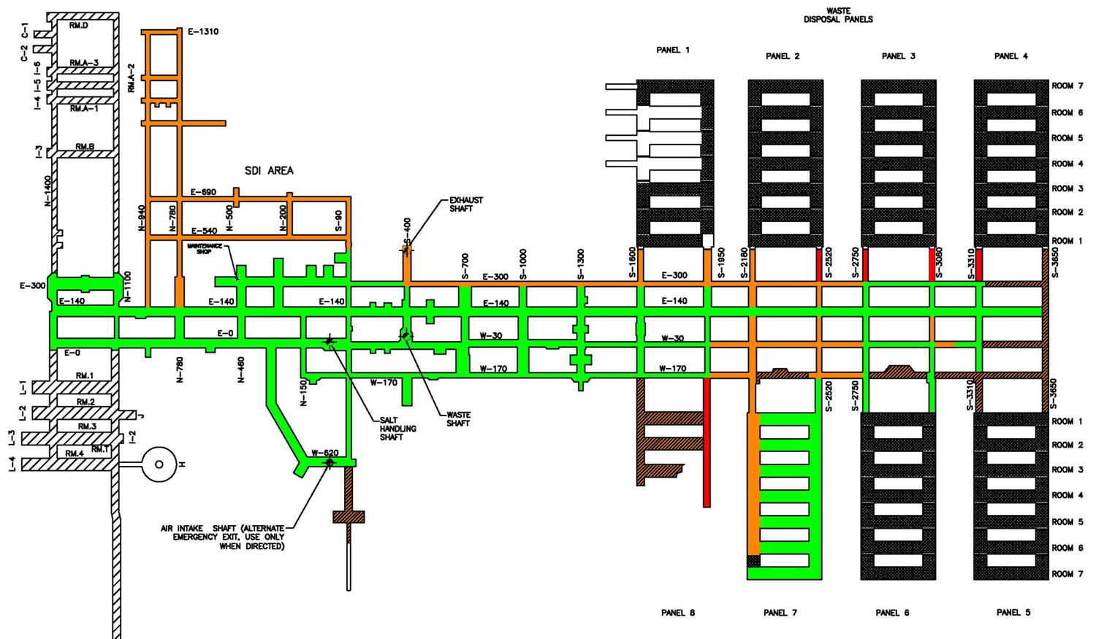
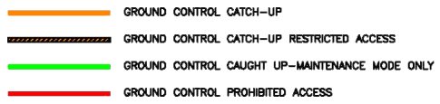
Ground Control

