Slide 1
Ventilation Systems Capital Asset Projects Safety Significant Confinement Ventilation System (15-D-411) Exhaust Shaft (15-D-412)
Ronald E. Gill
Acting Federal Project Director / Operations Activity Manager
Carlsbad Field Office
Office of Environmental Management
February 19, 2016

Slide 2
Project Management Background
DOE Order 413.3B “Program and Project Management for the Acquisition of Capital Assets”
Disciplined approach for acquiring capital assets
Project goes through “Critical Decisions (CD)” during the development and approval of the project
Many independent reviews by other organizations to ensure acquired asset will meet the mission need
Secretary of Energy Memorandum December 2014 “Improving the Department’s Management of Projects”
Additional review requirements
Independent Analysis of Alternatives to General Accounting Office standards
Additional design maturity requirements for Hazard Category 2 Nuclear Facility at CD-2

Slide 3
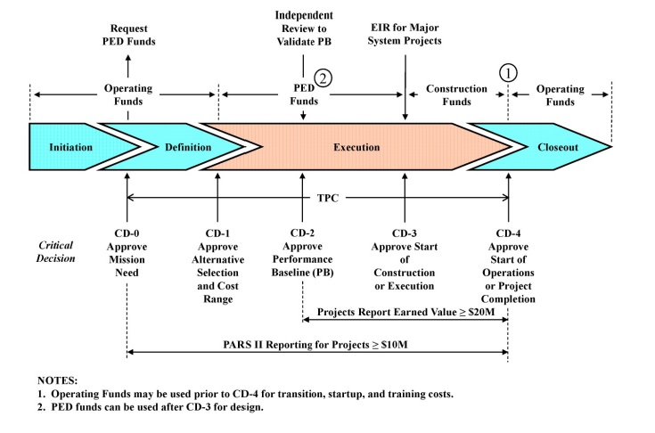
Critical Decision (CD) Process
Line Item Funding
Base Funding
Base Funding
Oct. 24, 2014
Dec. 23, 2015

Slide 4
Critical Decision 1 – Approve Alternative Selection and Cost Range
CD-1 documentation and reviews consisted of the following:
Acquisition Strategy
Preliminary Project Execution Plan
Tailoring Strategy
Independent Analysis of Alternatives
Independent Cost Review
Independent Project Review
Conceptual Design Report / Conceptual Safety Validation Report
Conceptual Safety Design Report
National Environmental Policy Act Strategy

Slide 5
Analysis of Alternatives
Nuclear Waste Partnership (NWP) proposed a total of 24 alternatives with 2 requiring additional study through Conceptual Design
Alternative 1-A
Provide a new unfiltered exhaust shaft for mining operations and use existing exhaust shaft with additional filtration capacity for full waste handling and disposal operations
Alternative 1-D
Existing exhaust shaft with filtered ventilation sufficient for full mining and waste handling and disposal operations
An Independent Analysis of Alternatives was contracted with Trinity Engineering Associates that developed 4 alternatives that were similar to the ones developed by NWP

Slide 6
Approval of CD-1
Approved Acquisition Strategy
Approved Preliminary Project Execution Plan
Approved Tailoring Strategy that combined CD-2 and CD-3
Alternative 1-A selected with two projects, cost ranges, and proposed CD schedule
Safety Significant Confinement Ventilation System (15-D-411)
Use existing exhaust shaft with additional filtration capacity for waste handling and disposal operations
$189M to $280M
Exhaust Shaft (15-D-412)
New unfiltered exhaust shaft for mining operations
$81M to $118M

Slide 7
Path Forward
Design Request for Proposal on the two projects
Design in Fiscal Year 2016, completion in Fiscal Year 2017
Long Lead Procurements in Fiscal Year 2017
Salt Removal Systems
Exhaust Fans
Filter Housings
Diesel Standby Generators

